Slide 1
OCaml: Introduction
CMSC 330: Programming Languages

Slide 2
What is OCaml?
A general-purpose functional programming language
Support functional, imperative, and object-oriented styles
High reliability, strong static typing, and efficient machine code
Originated in the ML family

Slide 3
Setting Up the Environment
We have set up an environment for you on the Arch Linux server
OCaml Platform: https://ocaml.org/install
Online try it: https://ocaml.org/play
Demo: VS Code + Linux server
To compile, use the command:
ocamlopt source_file.ml -o test_file_name

Slide 4
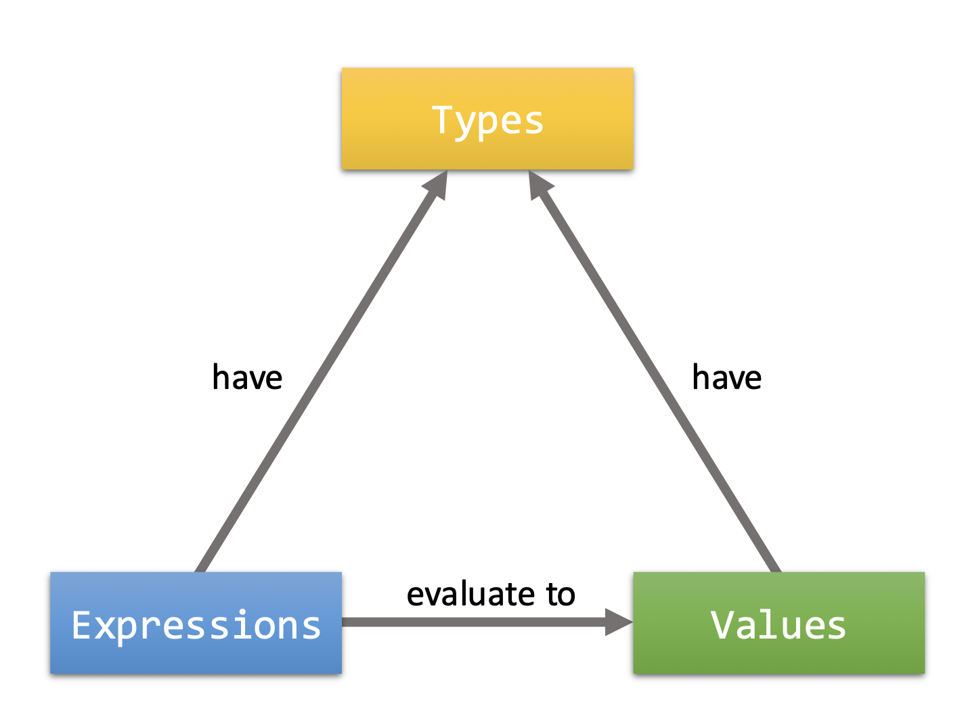
Types, Expressions, and Values

Slide 5
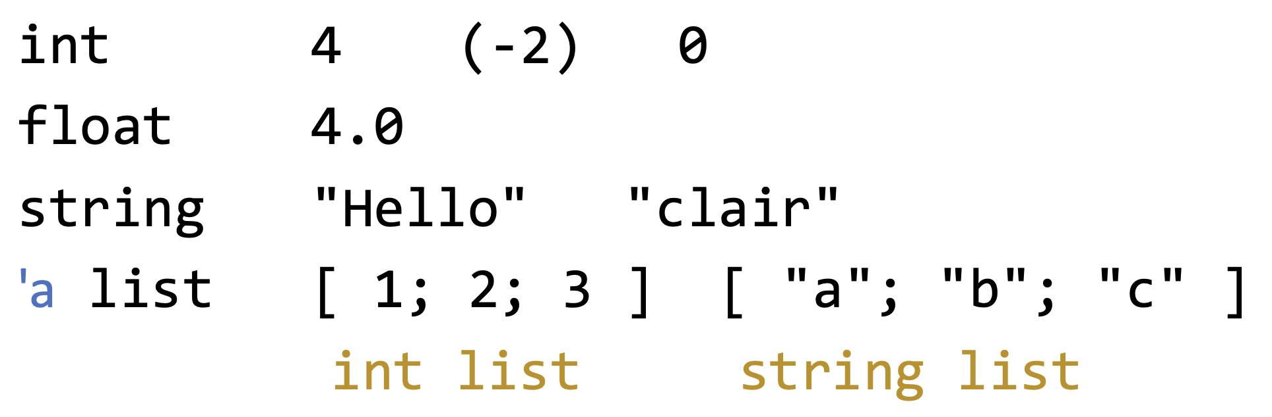
OCaml Types
In OCaml, types will be inferred
We normally do not write any types explicitly
Note: 'a list = a list of elements of any type ‘a (polymorphic)

Slide 6
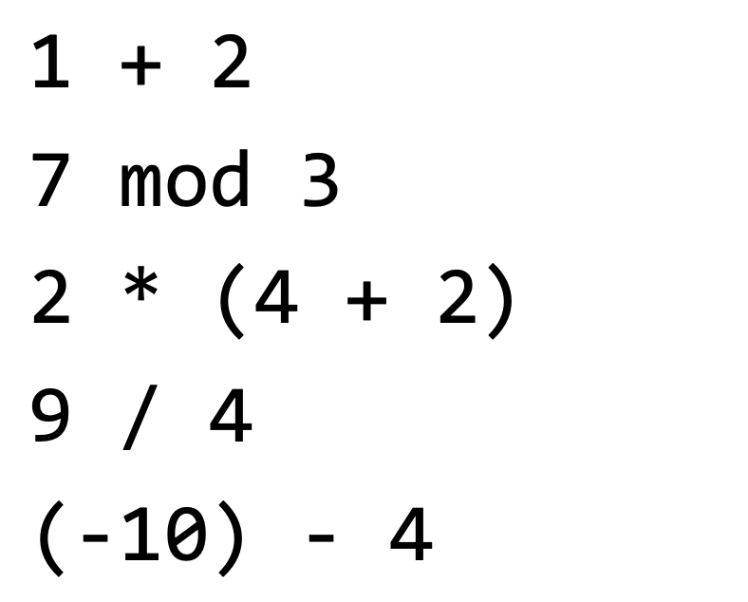
OCaml Expressions - int

Slide 7
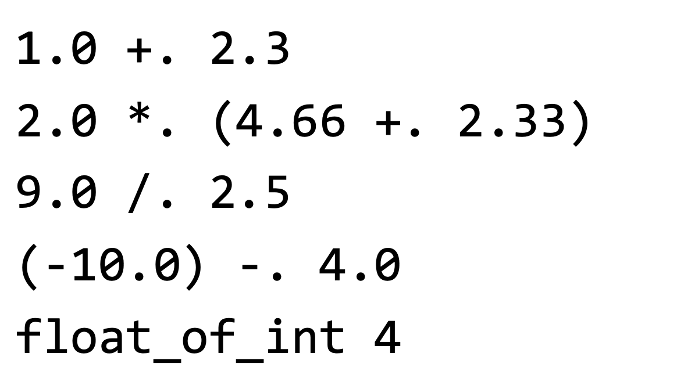
OCaml Expressions - float

Slide 8
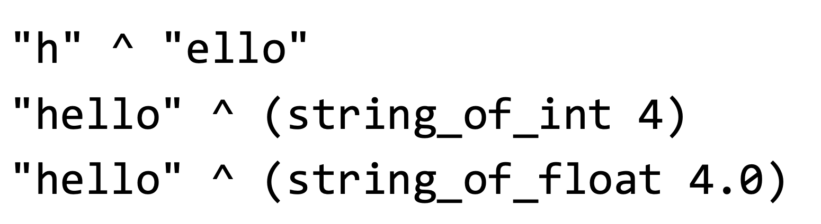
OCaml Expressions - string
Notes:
String_of_int: int -> string

Slide 9
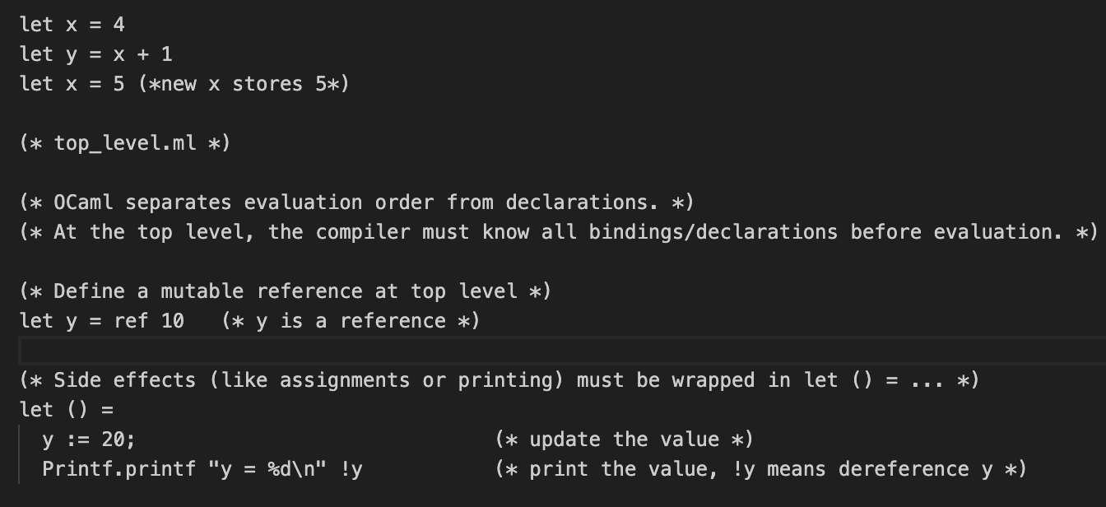
OCaml Variables
OCaml Variables are by default immutable
But you can create a reference, and update the reference using :=, dereference it using !

Slide 10
Functions
Functions are basic building blocks of OCaml
Functions are expressions
Functions have a type
Functions (when fully invoked) yield a value

Slide 11
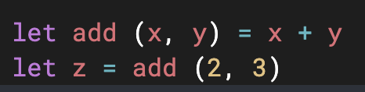
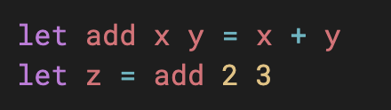
Function Syntax
1. Tupled arguments
Type: int*int -> int
2. Currying (Do This!)
Type: int -> (int -> int)

Slide 12
Currying
In pure functional programming, functions conceptually take ONE argument at a time
Multi-argument functions are expressed as a sequence of single-argument function applications
In the example:
add x returns a function that maps an int y to another int x + y
So type: int -> (int -> int)

Slide 13


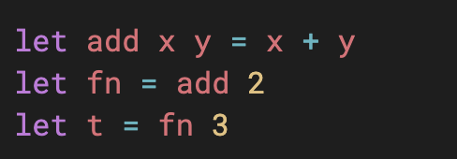
Currying
Abbreviated:
Full:
Function evaluation

Slide 14
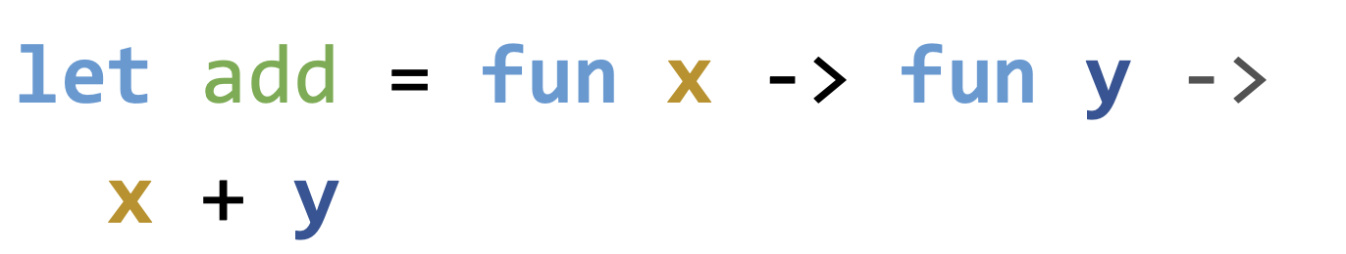
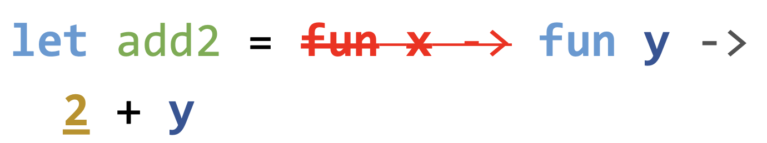
Partial Evaluation
Only Curried arguments allow partial evaluation

Slide 15
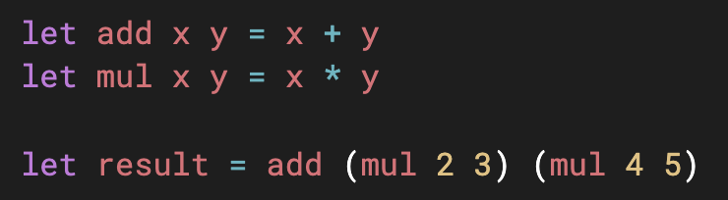
Applicative Order (Eager Evaluation)
Arguments of a function are evaluated first (left to right), then the function is applied.
Applicative order evaluates (mul 2 3) first, then (mul 4 5)
Then apply add

Slide 16
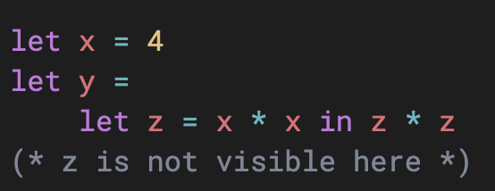
Local Bindings
Bindings are applied at the global scope
If we want a local binding that is temporarily used, we have: let .. in ..

Slide 17
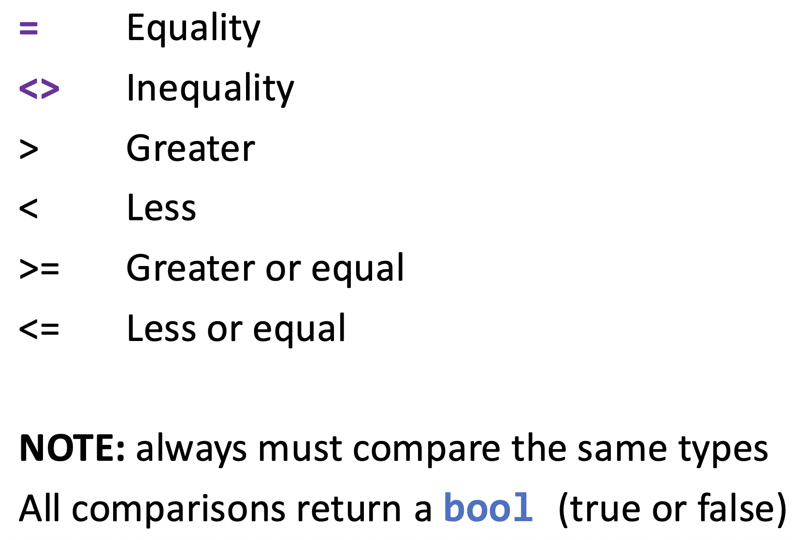
Basic Control Flow
if … then … else

Slide 18
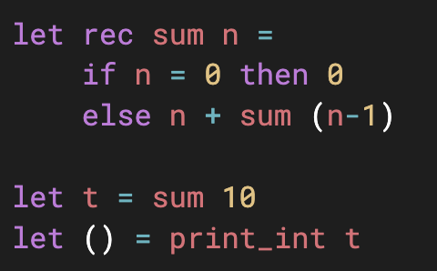
Recursive Function
Need the keyword rec

Slide 19
Lists
Lists are immutable (cannot be changed)
Finite sequence of elements
All elements must have the same type
Empty list: []
[1; 2; 3]
1::[2;3]
1::2::3::[]
Data type: ‘a list

Slide 20
List Operators
::
Cons: prepend a single element to the front of a list
NO modification, type must match, original list can be empty
E.g. 1::[2; 3], 1::2::3::[]
Type: ‘a -> (‘a list -> ‘a list)

Slide 21
List Operators
@
List concatenation: append a list to the end of another list
No modification, type must match
E.g. [1]@[2; 3; 4], [1; 2]@[3]
Type: ‘a list -> (‘a list -> ‘a list)

Slide 22
List Observers
List.hd returns the fist element of a list
Type: ‘a list -> ‘a
List.tl returns the rest of a list (other than the head)
Type: ‘a list -> ‘a list
List.length returns the number of elements of a list
Type: ‘a lsit -> int

Slide 23
Pattern Matching
Like an if-else, but checks the structure of data (e.g., empty list, head/tail of a list, tuple).
Keywords:
match … with → explicit pattern matching
function → shorthand for matching a single argument

Slide 24
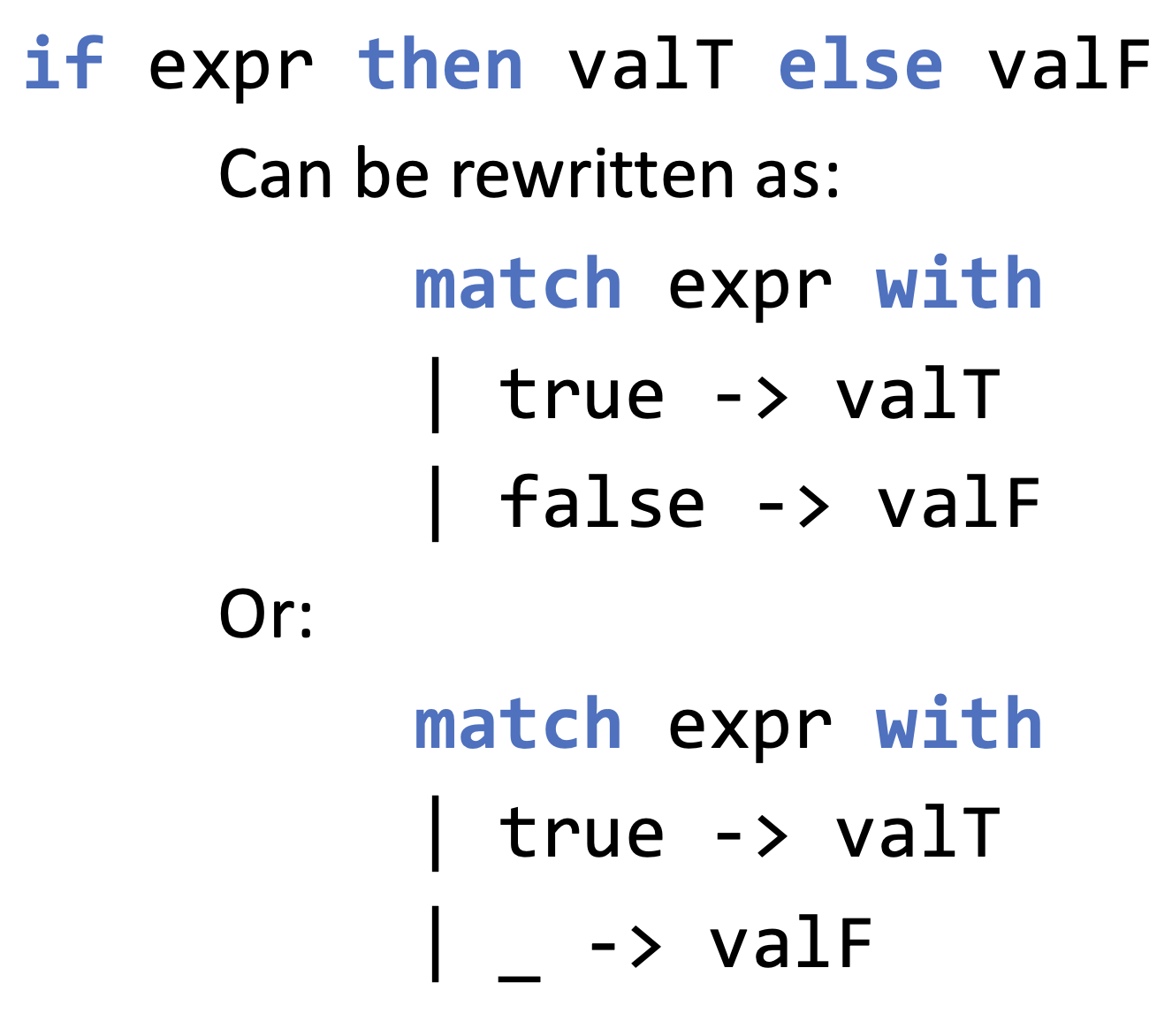
Pattern Matching on Boolean Values
_ : wildcard pattern, matches any value, but does NOT bind it to a name

Slide 25
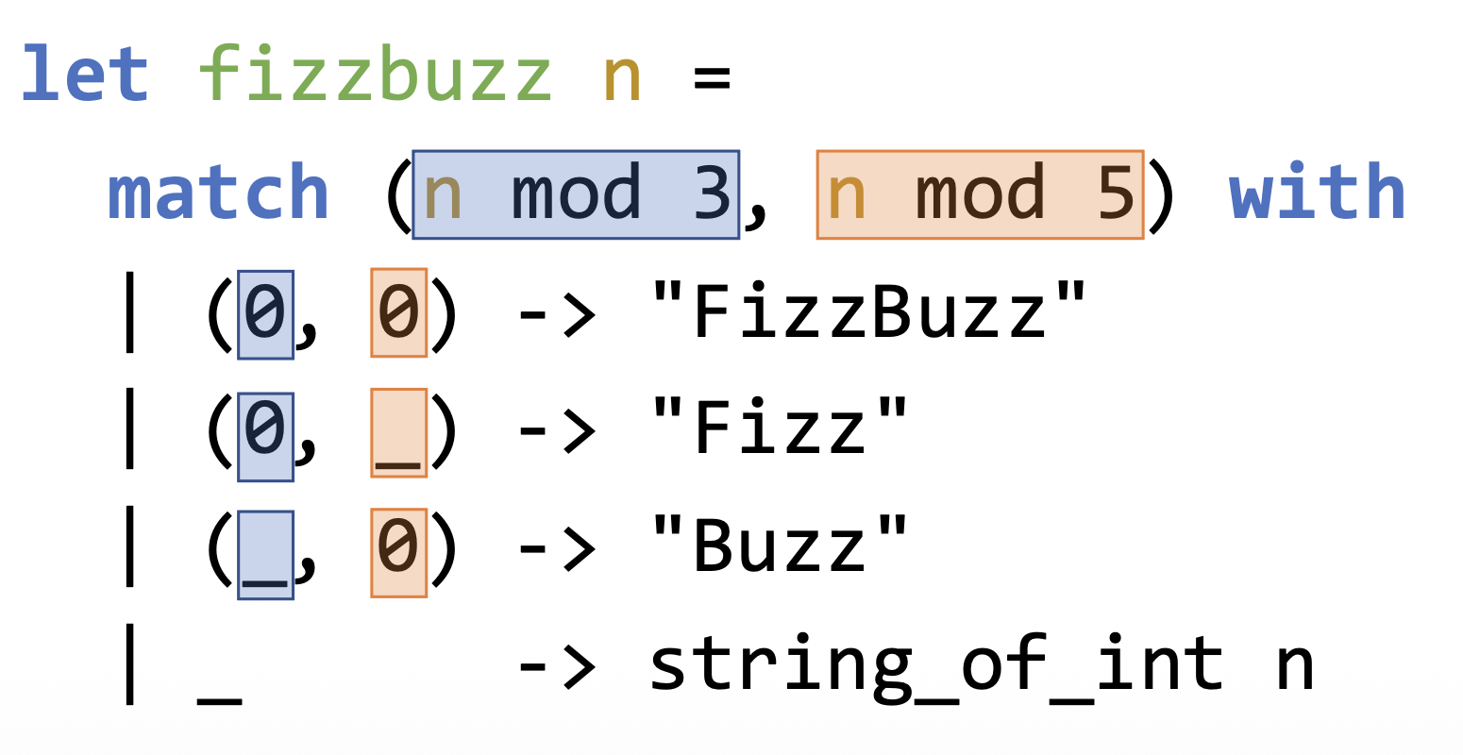
Pattern Matching on Tuples

Slide 26
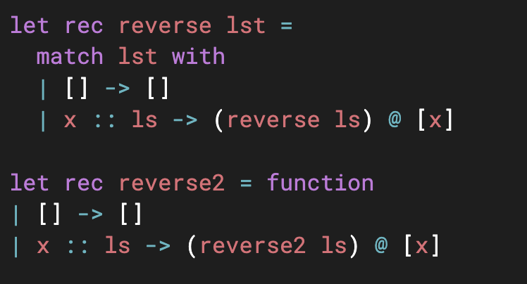
Pattern Matching on Lists
Notes:
Keyword function is syntactic sugar for:
fun x -> match x with ...
So:
function immediately performs pattern matching on its single argument.

Slide 27
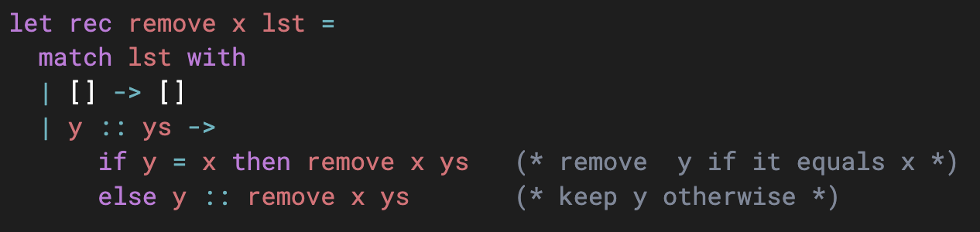
More Examples and Exercises
Remove all occurrences of a given element x from a list
Rewrite it using the keyword function
Type?

Slide 28
More Examples and Exercises
Return the last element of a list
Type?
Notes:
let rec last lst =
match lst with
| [] -> failwith "Empty list has no last element"
| [x] -> x (* only one element → return it *)
| _ :: xs -> last xs (* otherwise, recurse on the tail *)

Slide 29
More Examples and Exercises
Return a new list by applying a given function f to each element of a list
Type?
Notes:
let rec map f lst =
match lst with
| [] -> []
| x :: xs -> (f x) :: map f xs

Slide 30
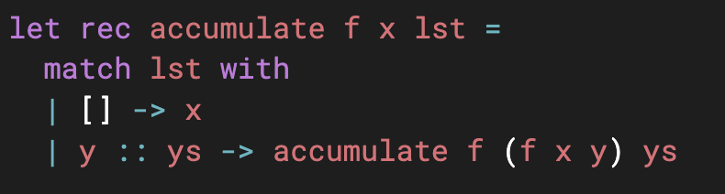
More Examples and Exercises
Check this example:
What is the type of f? not that x and y may not have the same type
What is the type of accumulate?
What does accumulate do?
Notes:
x: a
lst: ’b list
f: a->b->a
Accumulate: (a->b->a)->a->’b list->a
It folds the function f over the list lst, with initial value x

